Slide 1

Community Stormwater Solutions
Marylin Veiman Echeverría
mveiman@cbtrust.org l 410-974-2941 ext. 130
DOEE & CBT grant program
Notes:
Welcome to the Chesapeake Bay Trust, my name is Marylin Veiman Echeverria.

Slide 2
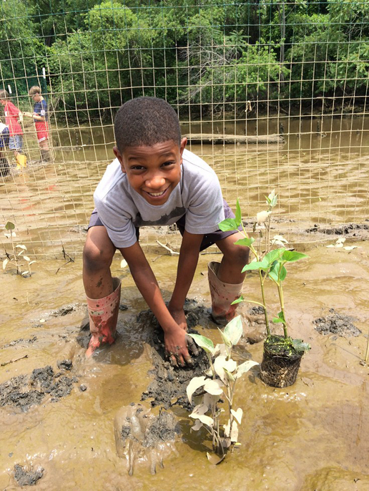
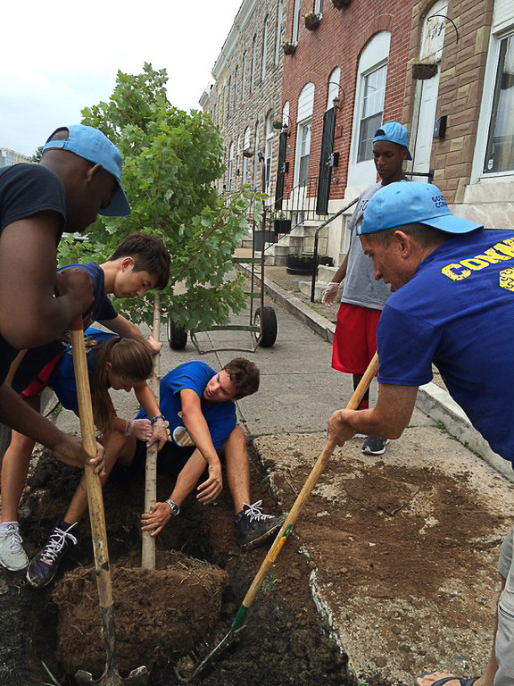
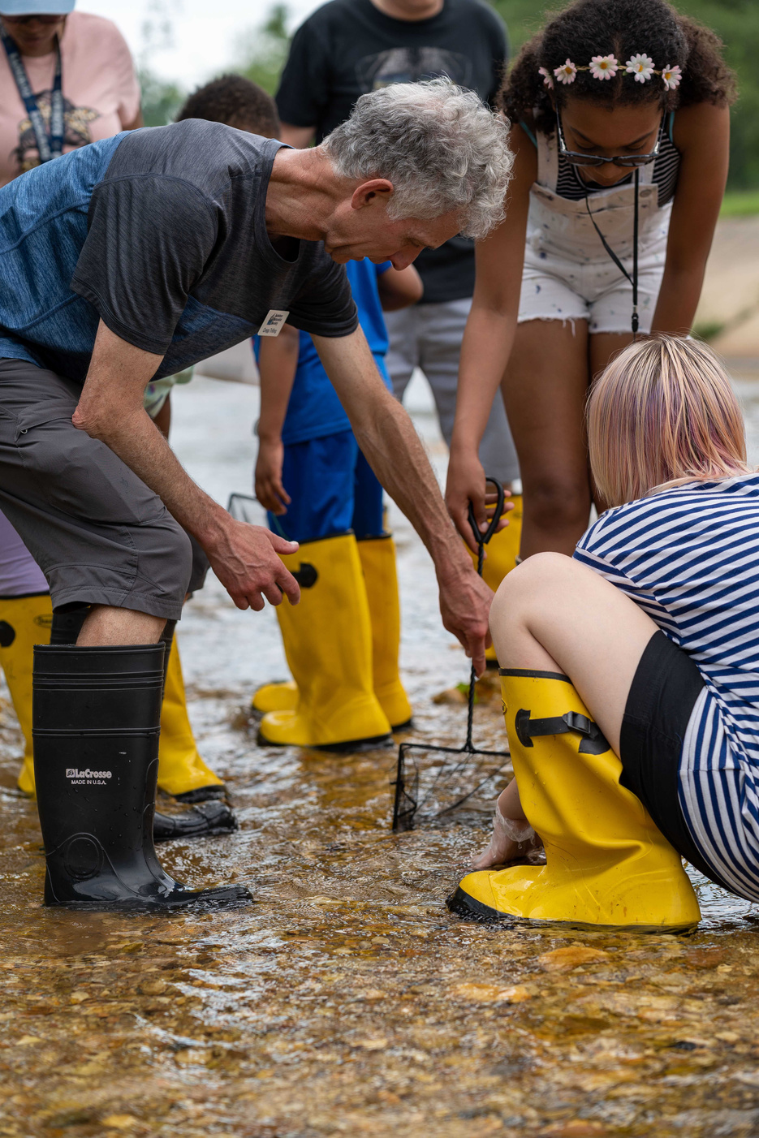
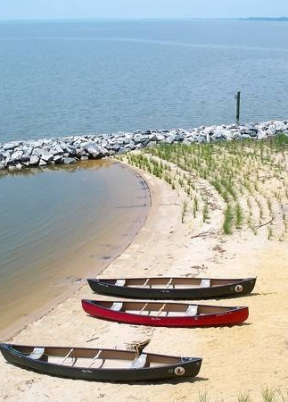
Topics
01
02
03
04
Overview of:
Chesapeake Bay Trust & the Community Stormwater Solutions grant program
Grant program Project Areas and past project examples
Application process, budget planning and spreadsheet
What happens after applications and available resources
Notes:
This is an overview of the Trust, the DC-CSS program, the application process and what to expect after your application. I appreciate your time filling the survey, if you did not have time and would like to fill it out, I would really appreciate it.

Slide 3

Chesapeake Bay Trust
Mission
To engage and empower diverse groups to take actions that enrich natural resources and local communities of the Chesapeake Bay region.
Vision
The Chesapeake Bay and local watersheds are healthy and safe, our waters are fishable and swimmable, local communities benefit from these healthy resources, and everyone participates in restoring and protecting our natural resource treasures
Goal
We believe that getting residents involved is key to restoring the Chesapeake Bay.
cbtrust.org
Notes:
A bit about The Trust: This is a non profit organization created in 1985 by the Maryland General Assembly. The Trust’s mission is to engage and empower diverse groups to take actions that enrich natural resources and local communities of the Chesapeake Bay region. The Trust believes that communities are the center to restoring the watershed, with that goal in mind we facilitate funding so that communities can be the leaders of that restoration. The Trust has funded over $160 million in grants since 1985

Slide 4
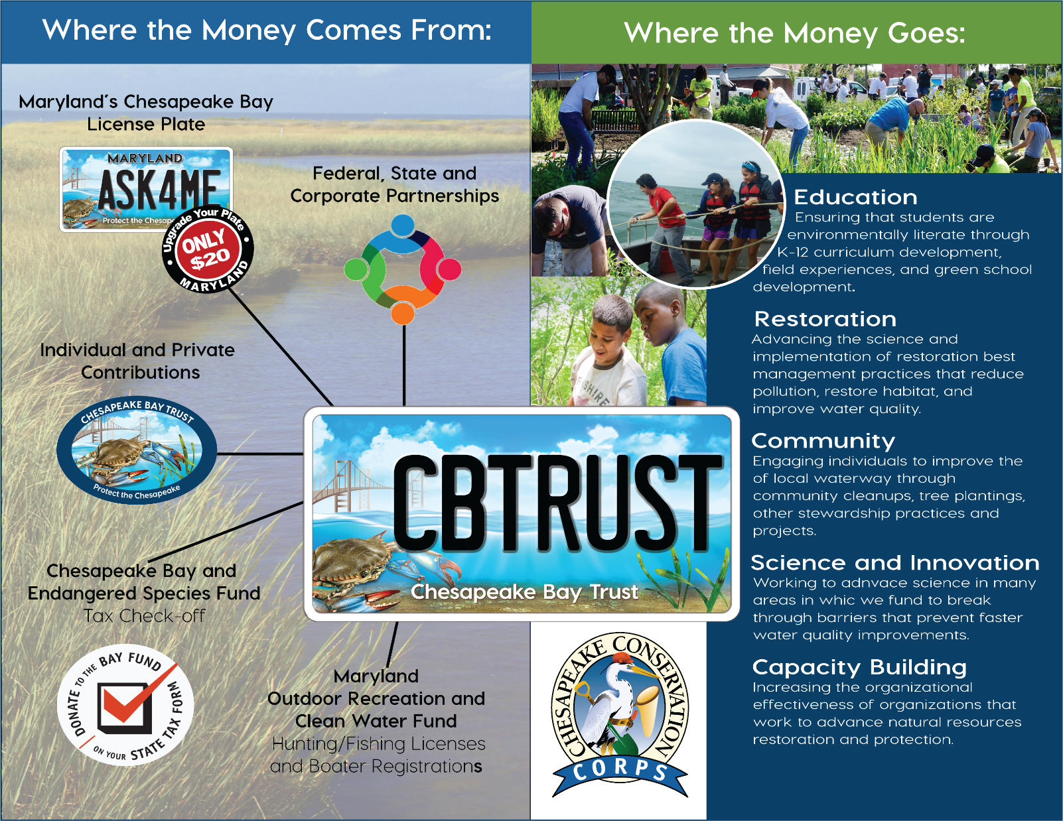
Notes:
Where does the money come from?
We have several funding sources, our general funds come from the Maryland’s Chesapeake Bay license plate, and others are the tax check for the Hunting and Fishing License Registration. There are many other programs with partnerships such as the National Oceanic and Atmospheric Administration (NOAA), Department of Energy and the Environment, Environmental Protection Agency. We also have partnerships with local government entities, such as Charles County and Anne Arundel. All those funds go toward our grants programs.

Slide 5

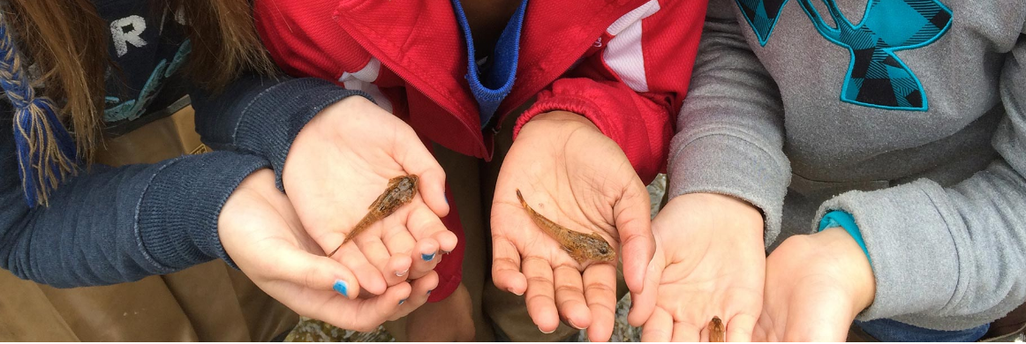
Program overview
Environmental Education
District of Columbia
Outreach and Engagement
Community Engagement and restorations Mini Grant
Outreach and Restoration
Sponsorship
Veterans Engagement
Community Stormwater Solutions
Donation and Reuse
Urban Agriculture
Environmental Education
Youth Environmental Education Grant Program
Outdoor Learning Network Initiative (OLNI)
Notes:
The Trust funds a spectrum of activities from environmental education to create knowledge and awareness to restoration through invasive plant removal, tree planting, stormwater gardens, green infrastructure shoreline restoration amongst other practices. You can take a look at our website for more information on other opportunities.

Slide 6
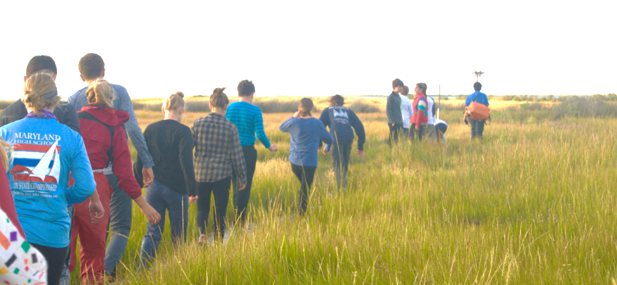
Restoration and Science
County Specific
Chesapeake Oyster Innovation
Goal Implementation Team Support (GIT)
Green Streets, Green Jobs, Green Towns (G3)
Non Tidal Wetlands Awards Program
Outreach and Restoration
Pioneer
Pooled Monitoring Initiative’s Restoration Research
Urban Trees
Watershed Assistance
Anne Arundel County
Community Tree Planting
Forestry and Forested Land Protection
Watershed Restoration
Charles County
Charles County Forestry
Montgomery County
Clean Water Montgomery
Prince George’s County
Rain Check Rebate
Stormwater Stewardship
Heading
cbtrust.org
Notes:
There are also programs for restoration and science and county specific programs.

Slide 7








Community Stormwater Solutions
Partnership between the Trust and the Department of Energy and Environment (DOEE)
Goals: Provide funding for innovative, community-oriented and –inspired projects, aimed at improving water quality in the District of Columbia, reducing litter, and raising awareness about what we can do to restore our rivers, streams, and parks.
Goals: Implement projects that aim to educate a priority audience, increase knowledge, or lead to behavior change that ultimately improves the health of the District’s waterways.
Funding amount: Up to $35,000
Application deadline: March 28th 2024 at 4:00 pm
Notes:
This programs funding comes from the Department of Energy and Environment DOEE and the Trust. The Community Stormwater Solutions Grant Program provides funding for innovative, community-oriented and –inspired projects, aimed at improving water quality in the District of Columbia. You can be awarded up to $35,000 and the application deadline is March 28^{th at 4:00 pm} Please apply early, this is very important, once the portal closes, we can not reopen it, it closes automatically.

Slide 8
Who is eligible to apply?
Heading
The Trust welcomes requests from the following organizations for the DC- Community Stormwater Solutions Program:
Applicants physically located in the District of Columbia
Nonprofit organizations
Faith-based organizations
Government agencies
Universities/educational institutions
Private Enterprises.
Eligible applicants will have and maintain in full force and effect during the term of the proposed project liability insurance coverage in connection with the performance or failure to perform services proposed.
cbtrust.org
Notes:
Who can apply? Applicants must be physically located in the District of Columbia and projects must be located in the District. If you are not located in DC, we recommend you work with a partner. Organizationsc can be
Nonprofit organizations
Faith-based organizations
Government agencies
Universities/educational institutions
Private Enterprises.

Slide 9
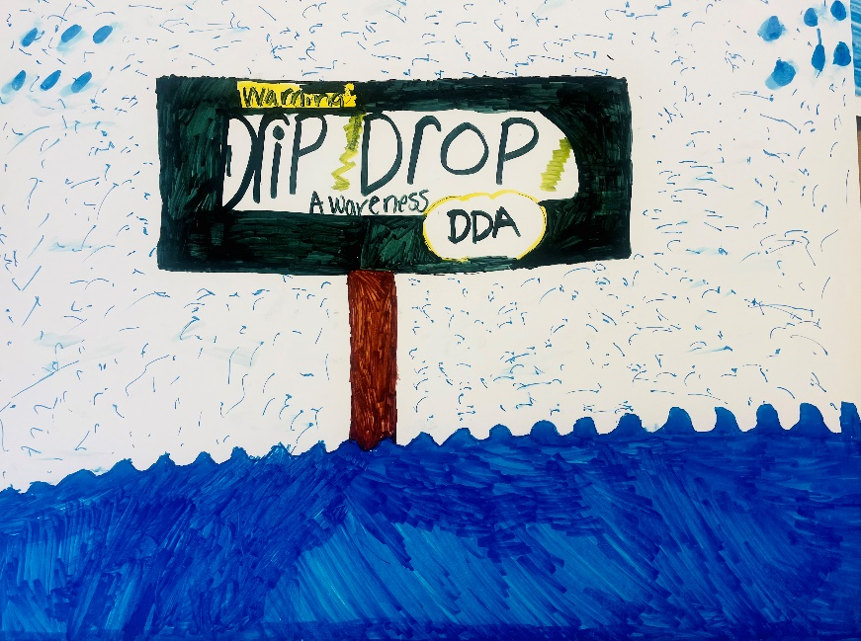
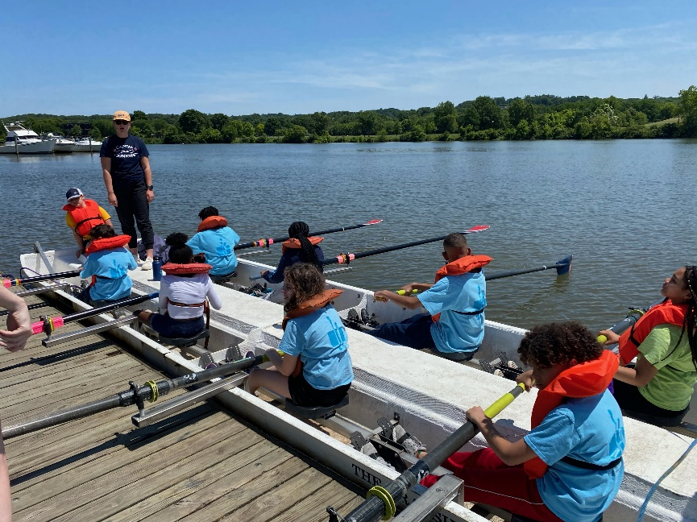
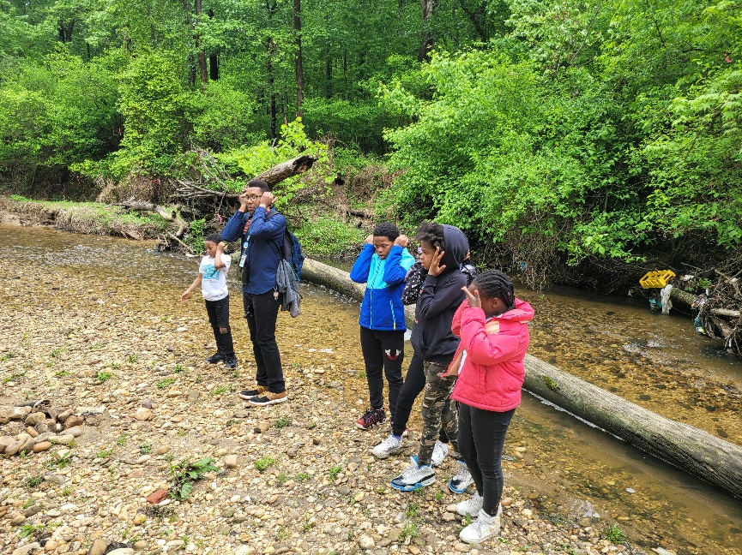
Project areas
Heading
Project area 1: Equitable access to natural areas along the Anacostia River
Project Area 2: Green infrastructure maintenance
Project Area 3: Provide pathways to green jobs
Project Area 4: Restore natural habitat
Project Area 5: Project-based learning to District of Columbia Public and Charter Schools students
Project Area 6: Transitioning from single use to reusable items at DC businesses
Project Area 7: Small events at Kingman and Heritage Islands
cbtrust.org
Notes:
When applying to the program, look closely at the project areas. DOEE is proposing seven project areas and two special focus areas. 1. For example, you could increase access to local green spaces for low-income communities or promote connection in a space that is rooted in the unique culture and history. 2. Green infrastructure, such as green roofs, rain gardens, rainwater harvesting and tree planting, applications should center around community stewardship of existing green infrastructure. 3. Applications in this project area should empower communities to find jobs and career resources on topics such as litter prevention, watershed health, stormwater management and green infrastructure. 4. Proposals in this category should intentionally assist in the recovery of a degraded ecosystem. This could include reducing or halting pollution, removal of non-native plants, and restoration with native species 5. A project in this category should incorporate project-based learning for District of Columbia Public and Charter Schools. Projects should apply techniques in their programs and activities that increase student awareness and knowledge or bring about behavior change, on issues related to water quality. 6. A project in this category should make a long-term transition from the regular use of single-use and disposable food service ware items to reusable alternatives at District businesses 7. Applicants can propose small-scale, family-friendly, community-inspired, environmentally-focused events at Kingman and Heritage Islands

Slide 10
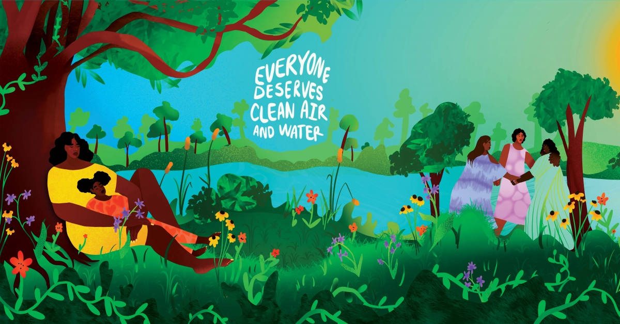
Special Focus Areas
Heading
Special Focus Area 1: Advance stewardship, environmental education, restoration, community engagement, and maintenance efforts in neighborhoods within the Oxon Run watershed and Oxon Run Park corridor in the District
Special Focus Area 2: Environmental Justice
cbtrust.org
Images from Mural by Amir Khadar, Anacostia Community Museum exhibit “To live and Breathe: Women and the Environmental Justice in Washington, D.C.”
Notes:
1. Special focus area Oxon Run: Projects in this area should engage communities and improve awareness of the benefits of this natural corridor. 2. Environmental Justice - Applications in this focus area can hold listening sessions, or work to understand the inequalities of environmental and development policies and find ways to reduce the impact of unequal exposure to hazards like flooding or creating access to green spaces.

Slide 11

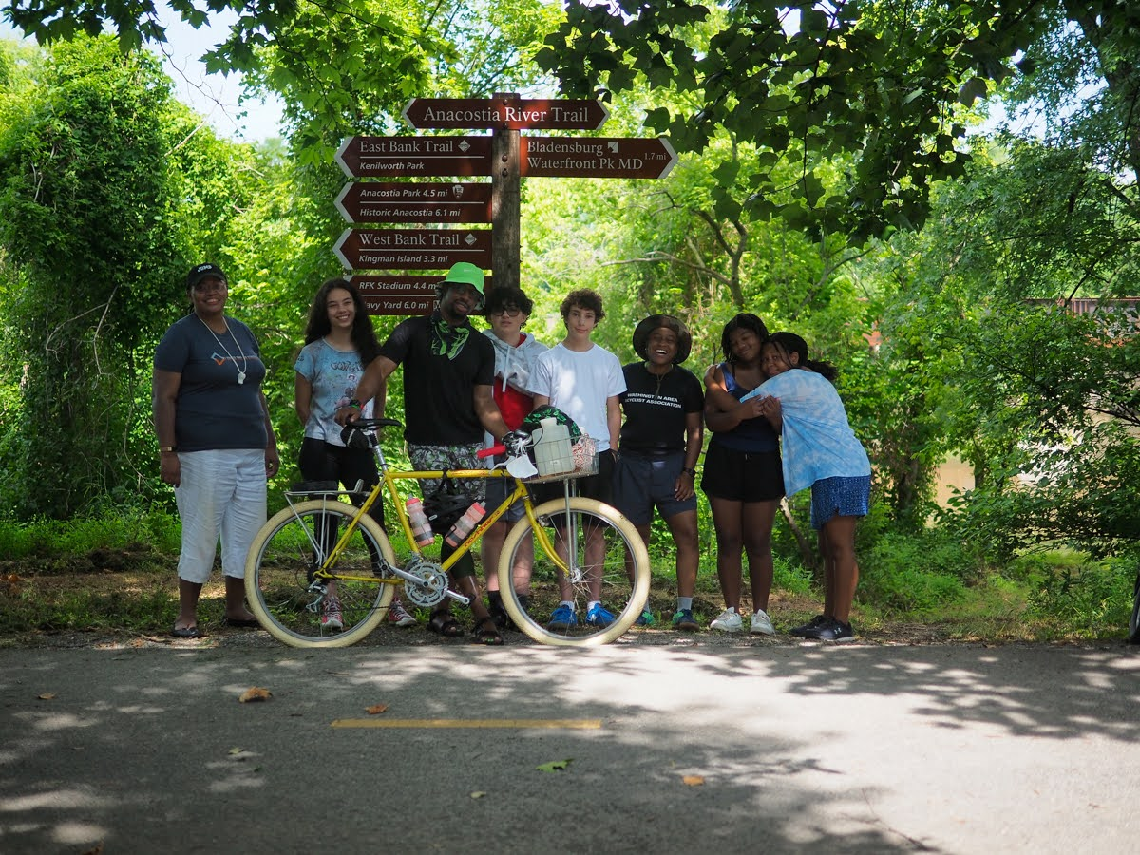
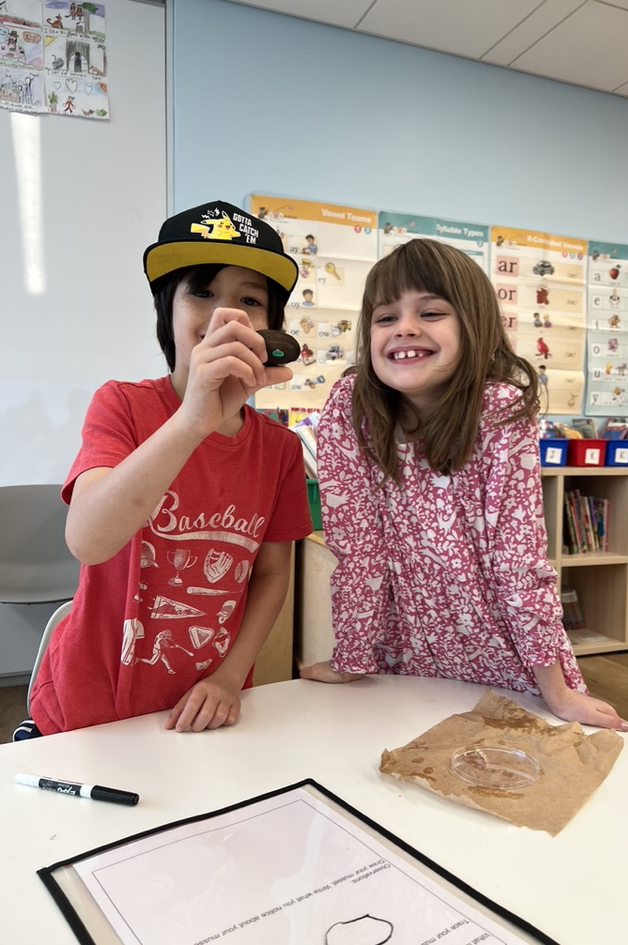
INNOVATE!
Notes:
The funders of this program would like to see innovative proposals from the communities. Don’t base your proposal solely on the examples we have provided, in fact, we have reduced the examples to motivate original proposals. Please contact me, we can talk, brainstorm and I can answer questions. If there is a question for the funders of this program, I can relay your questions to them.

Slide 12
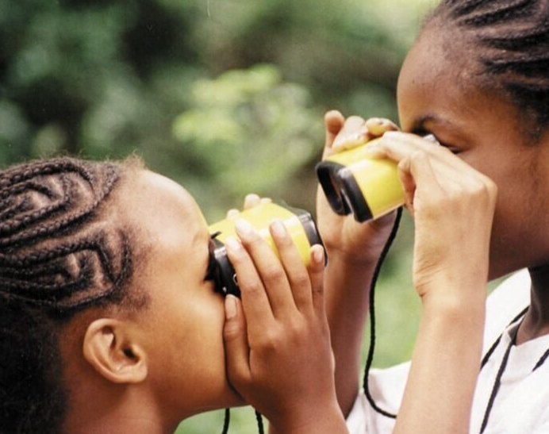
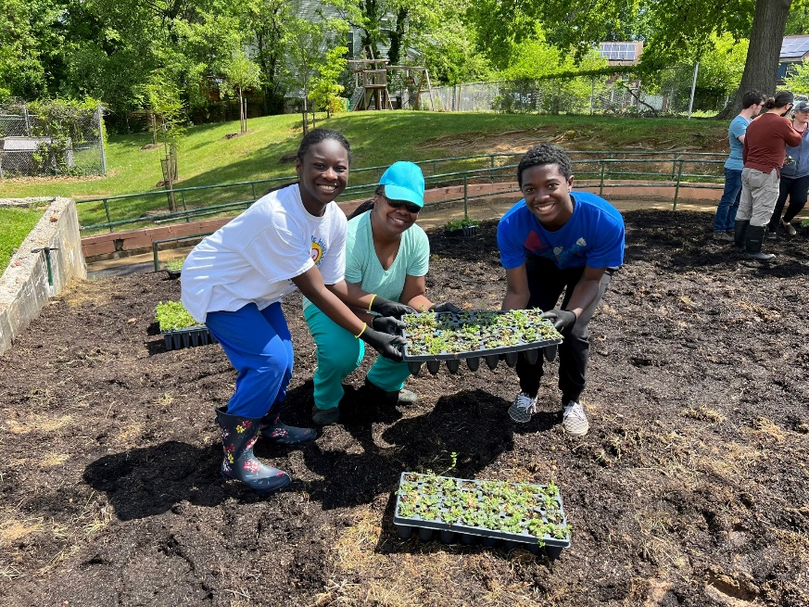
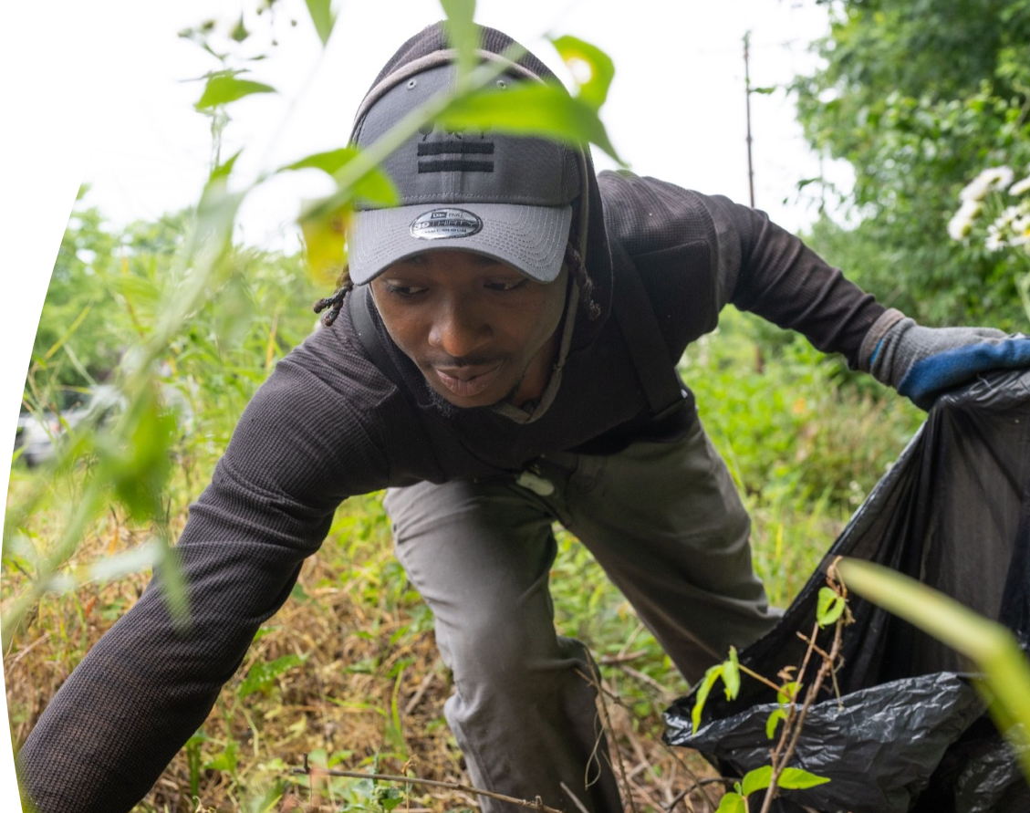
Examples of past projects
Heading
Green career recruitment and training for underserved groups.
Exploration of Kingman Island
Community gardening and native plant giveaways
Wheelchair accessible urban gardens
Afterschool programs
Summer camps
Rowing, kayaking and cleaning waterways
Watershed rehabilitation through non-native plant removal
Outdoor exploration for families
Water capture through rain-barrel installation
Listening sessions and investigation of Environmental Justice issues.
cbtrust.org
Notes:
Just read here.

Slide 13
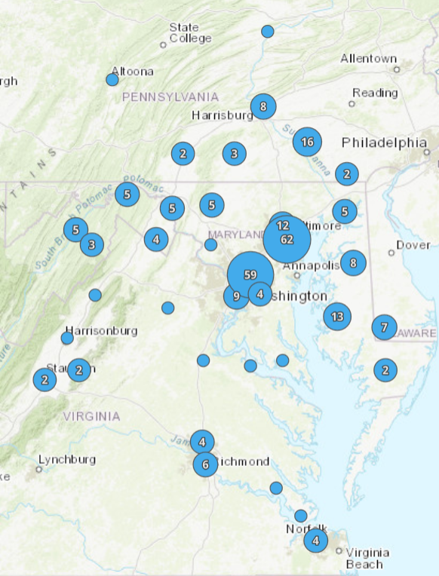
Learn More about Previously Awarded Projects
Chesapeake Bay Trust Awarded Projects Map https://cbtrust.org/impact-of-our-work/
DOEE Community Stormwaters Solutions Grants
https://doee.dc.gov/service/community-stormwater-solutions-grants
Notes:
DS – done
- you can learn more about the impact of these programs - CBT Award Projects Map – Impact of our work page – features all of the Trust projects and you can filter by the DC-CSS grant program

Slide 14
Tips for your grant application
Bring together the right partners
Schedule
Schedule a meeting with funders, if necessary, and send draft narrative/documents.
Obtain
Obtain supporting documents and letters of commitment from partners
Submit
Submit application
Partners
Read
Read the Request for Applications (RFA)
(includes project areas, required narrative questions, and scoring criteria)
Notes:
Share RFA with team

Slide 15
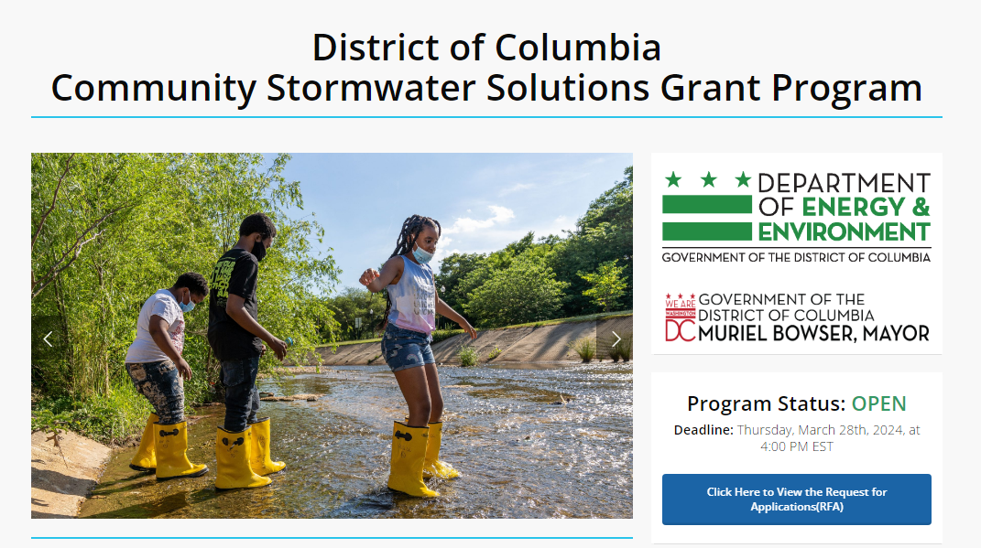
District of Columbia: Community Stormwater Solutions
https://cbtrust.org/grants/district-of-columbia-community-stormwater-solutions/
Notes:
This is the website where the RFA is located

Slide 16
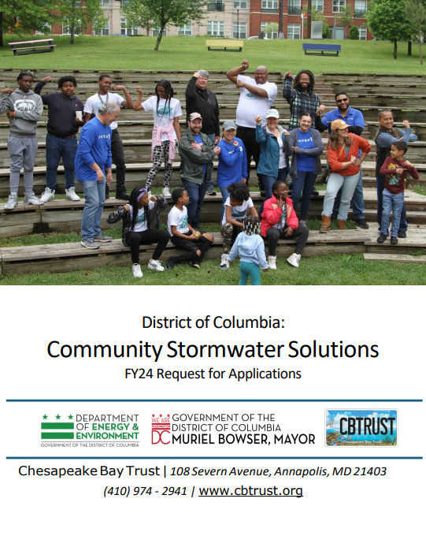
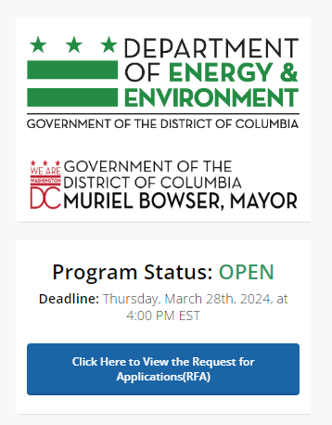
Request for Applications (RFA)
In the RFP you can find
Additional guidance
Evaluation criteria
Narrative questions
Online submission instructions
cbtrust.org
Notes:
Click on the button to download the RFA looks like what you see on the right

Slide 17
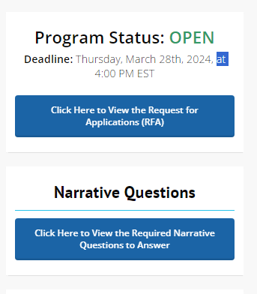
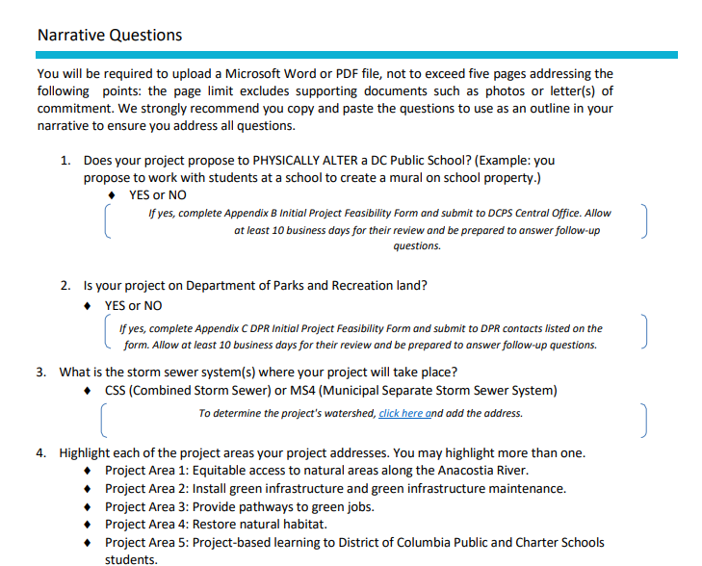
Narrative questions
In the same website you can find the narrative questions
cbtrust.org
Notes:
On this same website click on the button to download the Narrative questions these are your main guidance to write your proposal

Slide 18
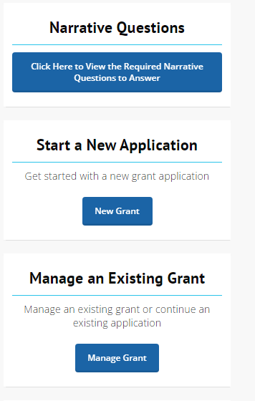
Start a new application or Manage an existing grant
Right below the RFA and the Narrative questions is the access to begin an application
cbtrust.org
Notes:
Right below you can start a new application

Slide 19
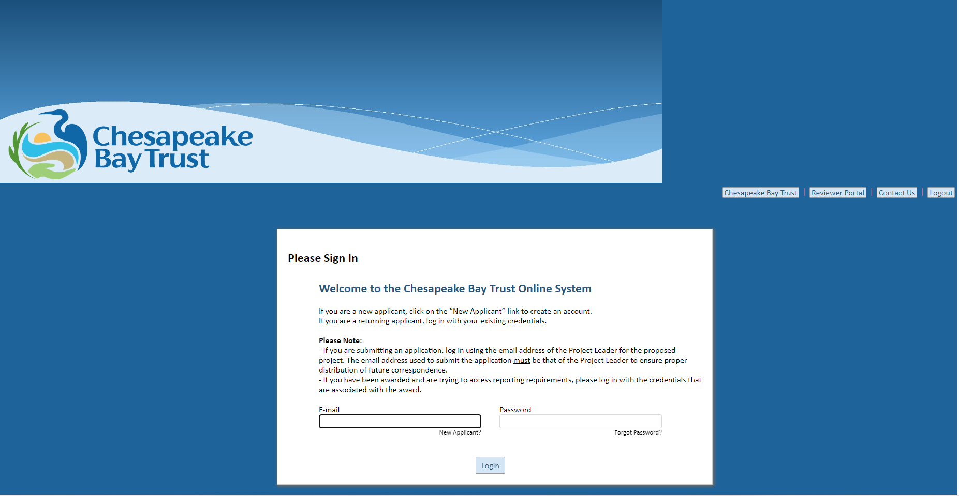
Online Portal to Access Application
Online Applicant Access Portal
Online Portal to Access Application
Notes:
We have an online access portal to submit your applications and supplementary documents. New applicants can create an account or returning applicants can just sign in.

Slide 20
On line application form
Four main components:
Online application fields
Narrative – copy and paste narrative questions
Budget
Upload a copy of your proposed budget using the Trust’s Financial Management Spreadsheet (FMS). Download the template from our website at https://cbtrust.org/forms-policies/ and fill out the “Application Budget” worksheet. Refer to the “Budget Instructions” of the RFA.
Additional budget justification
Supporting Documents
Letters of Commitment. To better understand the Trust’s definition of letter of commitment, visit our Forms and Policies webpage at https://cbtrust.org/forms-policies/.
Photos, concept plans, and other supporting documents.
Notes:
There are some important documents required by DOEE

Slide 21
Important documents
1. Promises, Certifications, Assertions and Assurances:
Each applicant must sign and submit the “Promises, Certifications, Assertions, and Assurances” (“PCA”) in Appendix A. Signing the PCA is a condition of eligibility for this grant. If the Applicant is not prepared to sign the PCA, it should not apply for a grant.
Compliance with the promises, certifications, and assurances in the PCA is a continuing condition of eligibility for this grant.
This form is administered by DOEE. Questions can be directed to Emily Rice at email: emily.rice@dc.gov; and phone number: (202) 535-2679.
2. IRS – W-9 Tax Form:
The Applicant must submit a current completed W-9 form prepared for the U.S. Internal Revenue Service (IRS). DOEE defines “current” to mean that the document was completed within the same calendar year as that of the application date.
Notes:
1. PCA - The PCA must be signed by the Applicant or, if the Applicant is an organization, by a duly authorized officer of the organization. This form is administered by DOEE. Questions can be directed to Emily Rice at email: emily.rice@dc.gov; and phone number: (202) 535-2679.
2. IRS W9 - The Applicant must submit a current completed W-9 form prepared for the U.S. Internal Revenue Service (IRS). DOEE defines “current” to mean that the document was completed within the same calendar year as that of the application date.

Slide 22
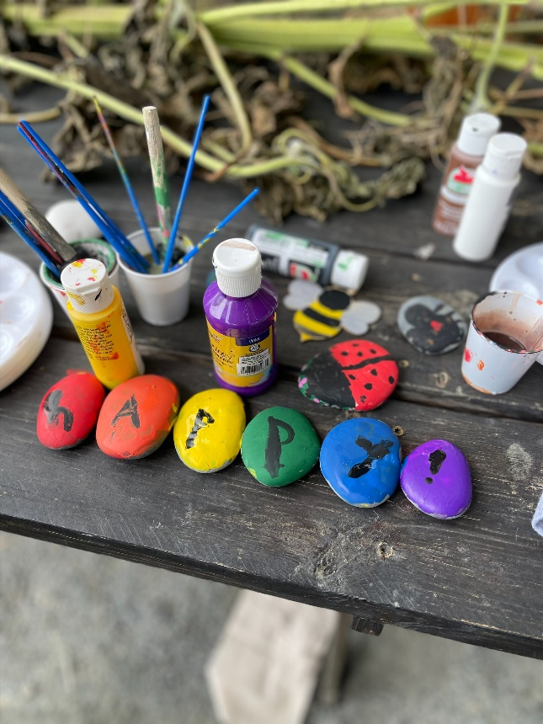
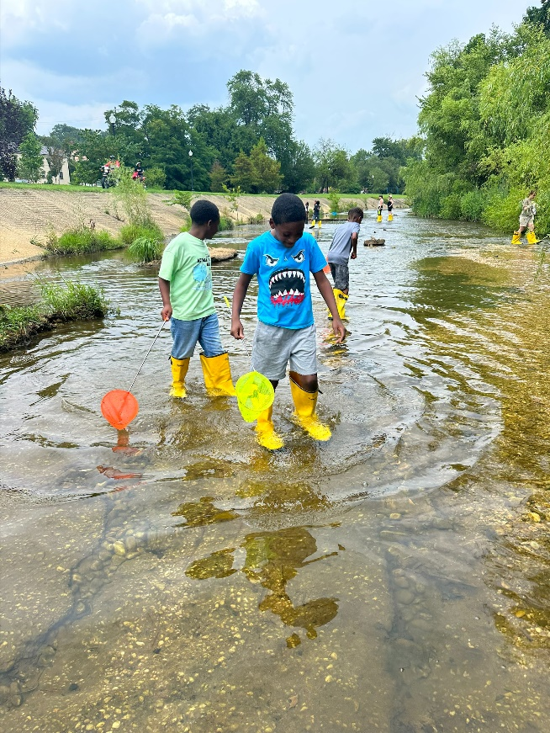
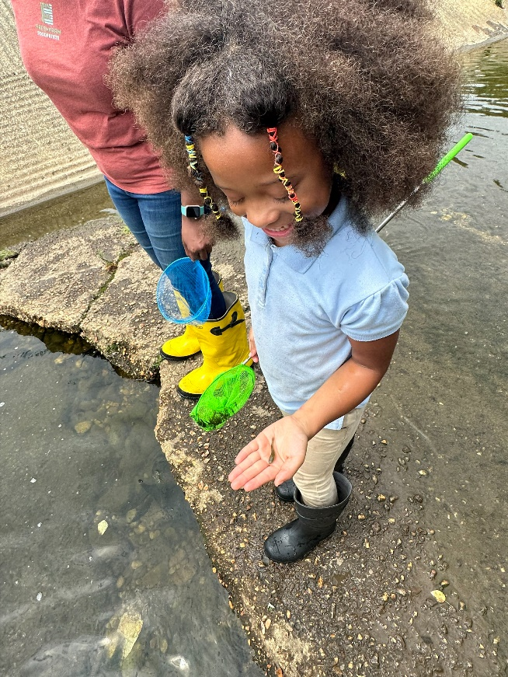
Important documents
3. Tax Exemption Affirmation Letter :
The tax exemption affirmation letter is the IRS’s determination letter of non-profit status. If this letter is not available, then the Applicant should provide its most recent IRS Form 990 tax return if one was submitted. If no return has yet been filed, the organization can submit its application for tax-exempt status. If the group has a supporting organization with an IRS tax-exempt status determination, then that organization’s tax exemption affirmation letter should also be submitted.
Notes:
3. Tax exemption affirmation letter - If there is no IRS tax exemption affirmation letter because the organization is a religious organization, then the Applicant may submit the best evidence it can of its status. Examples of potential best evidence for this purpose include, but are not limited to (i) a letter from the leader of the organization verifying that the organization is a religious group; (ii) a letter from the group’s board chair or similar official, verifying that the organization is a religious group.

Slide 23
Eligible Budget Items
Staff time to support project-related tasks
Consultant/Contractor costs to create designs
Supplies
Travel and Field Trips
Indirect costs (not to exceed 10% of the sum of direct costs)

Slide 24
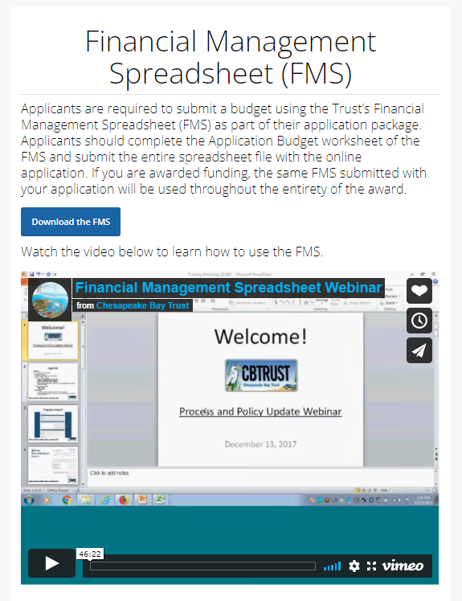
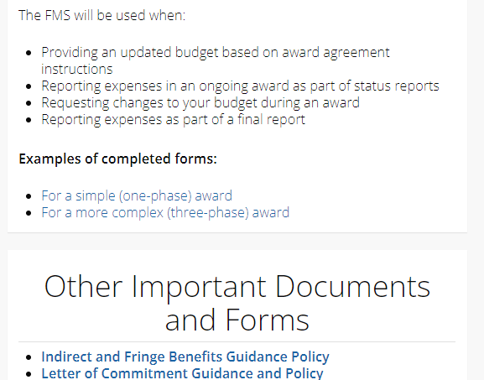
https//cbtrust.org/forms-policies/
Notes:
The budget should be submitted through the Financial Management Spreadsheet form Found in our website we have a video as well to guide you in the process.

Slide 25
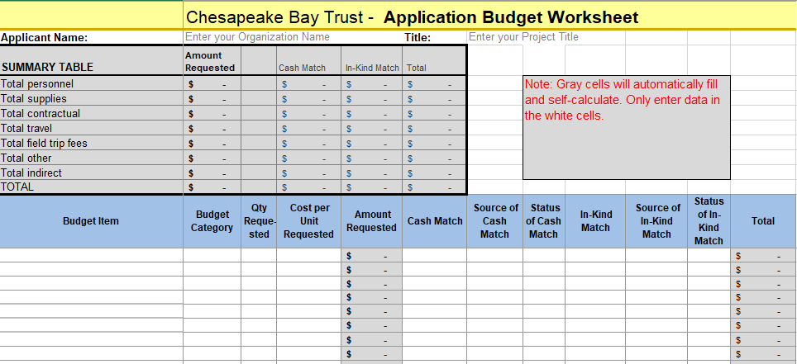
Financial Management Spreadsheet
https://cbtrust.org/forms-policies/
Notes:
As a brief overview the Application budget must be written into the application tab – colored yellow

Slide 26
Financial Management Spreadsheet
https://cbtrust.org/forms-policies/
Examples of Budget Items: Supplies for outdoor education like binoculars, nets, bug jars, or for a gardening project you can include soil, watering cans, tools and plants.
Notes:
The budget items should be detailed, for example binoculars, nets, soil, seeds, shovels.

Slide 27
Financial Management Spreadsheet
https://cbtrust.org/forms-policies/
Examples of Budget Categories: Personnel, supplies, contractual, travel, field trip fees, indirect
Notes:
The next column are budget categories, we have 7 categories – Include your budget categories, such as contractor, supplies, travel and field trips. Budget categories are limited to supplies, personnel, contractors, travel and field trips. Read the instructions carefully to know which field your budget items fit into. For example, soil, shovels and seeds would be supplies, buses to transport students would be field trips etc. Indirect are expenses to cover internal costs such as utilities, office rent etc.

Slide 28
Financial Management Spreadsheet
https://cbtrust.org/forms-policies/
Examples of Quantity Requested: In personnel place the number of hours, for supplies the number of supplies, for example if you are buying 50 bags of soil place the number 50.
Notes:
Examples of Quantity Requested: In personnel place the number of hours, for supplies the number of supplies, for example if you are buying 50 bags of soil place the number 50.

Slide 29
Financial Management Spreadsheet
https://cbtrust.org/forms-policies/
Examples of Cost per Unit: How much each bag of soil costs, or how much is the contractual service for watering.
Notes:
Examples of Cost per Unit: How much each bag of soil costs, or how much is the contractual service for watering.

Slide 30
Financial Management Spreadsheet
https://cbtrust.org/forms-policies/
Amount requested: This automatically populates by adding the Quantity Requested and the Cost Per Unit Requested. Double check that it adds to what you need.
Notes:
Amount requested: This automatically populates by adding the Quantity Requested and the Cost Per Unit Requested. Double check that it adds to what you need.

Slide 31
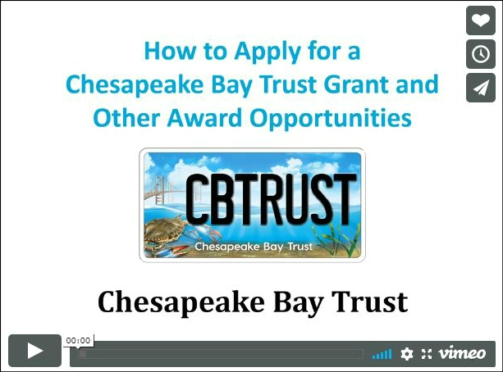
Watch our “How to Apply for a Grant” Video
Go to https://cbtrust.org/grants/ to watch this video for a detailed and thorough explanation of the application process.
cbtrust.org

Slide 32

How to apply for a Chesapeake Bay Grant - https://vimeo.com/853389125
How to manage a Chesapeake Bay Trust Award - https://vimeo.com/400210113
Financial Management Spreadsheet Webinar - https://vimeo.com/281495436
Forms and Policies https://cbtrust.org/forms-policies/
Resources https://cbtrust.org/additional-resources/
cbtrust.org
Notes:
Please take advantage of all our resources, we have several videos. I can provide these links in the chat.

Slide 33
What Happens After Submission
The Trust processes applications after the deadline
The Technical Review Committee reviews the applications
The TRC ranks and scores all applications based on the criteria listed in the “Evaluation Criteria” section of the RFP and then meets to discuss the application merits.
Notes:
Now, let's discuss what happens after you submit your application and it goes through the review process.
Each application is reviewed by a technical external peer review committee, called the Technical Review Committee (TRC), composed of individuals who are experts in the fields supported by the RFP and represent communities engaged by projects funded by the RFP.
The TRC will rank and score applications based on the evaluation criteria.

Slide 34
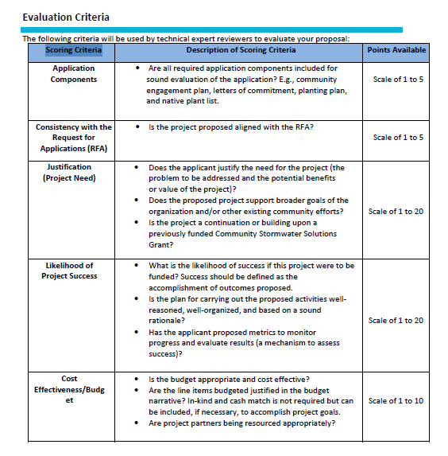
Evaluation Criteria and scores
Notes:
For your reference the scoring criteria is in the RFA, this is how the technical review committee will score each area of the applications. DOEE awards more points for the Special Focus Areas
Each application is reviewed by a technical external peer review committee, called the Technical Review Committee (TRC), composed of individuals who are experts in the fields supported by the RFP and represent communities engaged by projects funded by the RFP.
The TRC will rank and score applications based on the evaluation criteria we discussed earlier.

Slide 35
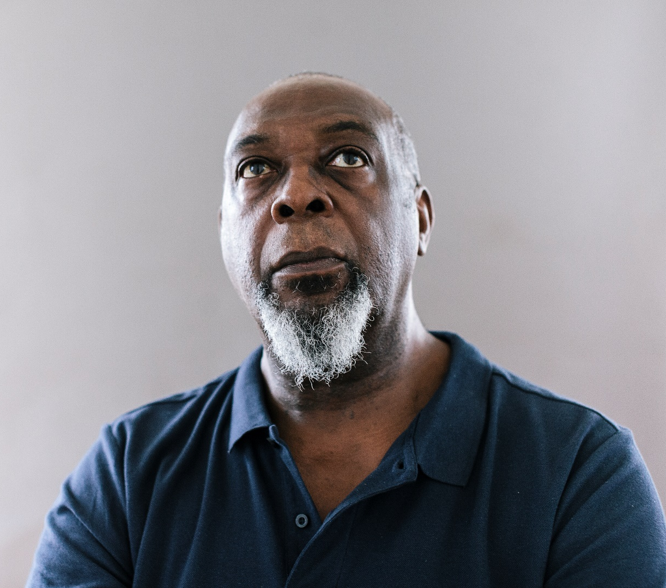
The TRC recommends a suite of applications to the Trust’s Board of Trustees for approval (for applications over $10k)
What Happens After Submission?
The Trust sends out decision letters by email to the Executive Officer and Project Leader identified on the application
Notes:
The reviewers make recommendations that are then presented to our board of trustees. The board checks the final approval of the applications. And Trust staff then send out decision letters to the organizations.

Slide 36

What Happens After Submission?
If awarded:
If declined:
Read and submit the signed award agreement
Review the award’s requirements
Submit the award’s requirements
Complete the work outlined in the application
Reach out to the Trust to schedule a debrief. The Trust will provide a summary of the Technical Review Committee feedback and recommendations on how your application could be improved and resubmitted to a future program.

Slide 37


For more information visit
cbtrust.org
Notes:
Thank you for joining us today. We now have an open space for questions and answers.

Slide 38

Please reach out to the contact listed on the
Community Stormwater Solutions Program webpage!
https://cbtrust.org/grants/district-of-columbia-community-stormwater-solutions/
Marylin Veiman Echeverría –Program Officer
mveiman@cbtrust.org
Thank You!
For more information visit
cbtrust.org

